Slide 1

Agilio Accelerated Contrail-vRouter
October 2019
By Simon Horman
Notes:
Software Architect
RH

Slide 2
Presentation Overview
Product Overview
Performance Expectations
TCO Improvement
Current Options for DP Forwarding
NFVI
Architectural Overview
Flow of Events
Operational Considerations
Agilio CX Series
Demo

Slide 3
Agilio-vRouter Overview

Slide 4



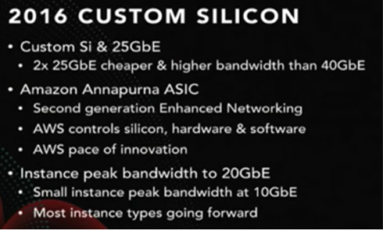
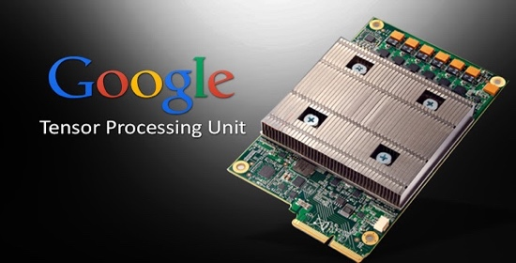
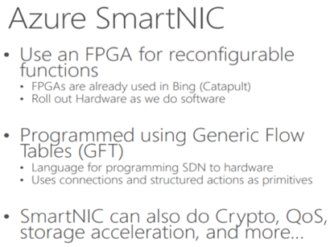
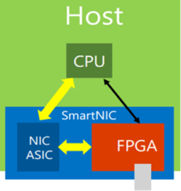
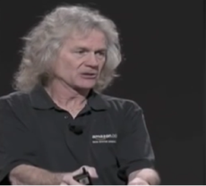
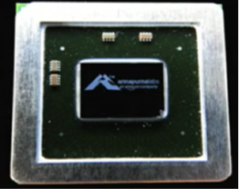


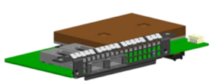
Market validation for hardware I/O acceleration
Large R&D budgets, deep acceleration software expertise Proprietary silicon and hardware-based acceleration
Rest of the market deploying cloud technologies need off-the-shelf solutions
Notes:
Accelerators are not new in industry
Essential to obtain reasonable TCO
All using proprietary technology; Juniper with Netronome provide a COTS solution with comparable performance

Slide 5

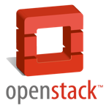


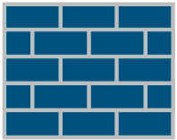








High Performance Virtualization: Contrail Solution with SmartNIC
1) Best in Class data path acceleration & offload – fully SW programmable
2) Feature compatible with SW only vRouter – Part of Juniper Contrail SW
3) Netronome HW accelerator – COTS product proven in life deployments
4) Low cost & significantly reduces TCO of traffic & compute intensive VNF
5) Full operational integration – adapted to your platform
ORCHESTRATOR
CONTRAIL CONTROLLER
(Config, Control, Analytics, TSN)
…
Fully SW programmable
SmartNIC vRouter Offload
Ethernet Adapter
x86 vRouter with Standard NIC
Notes:
What do you get
1..5
Switch dumb NIC with Netronome SmartNIC, which can also run as a dumb NIC by switching FW
Upstream in TF 5.0.2; GA in 1908
Juniper Product
Tier 1 support
Upstream Open Source (TF)
Cost - magional premium to standard NIC
No change to SW stack from operational POV
No lock-in
Further optimisation can be made
More efficient VNFs, offload of GTP, etc…
Microserver architecture

Slide 6
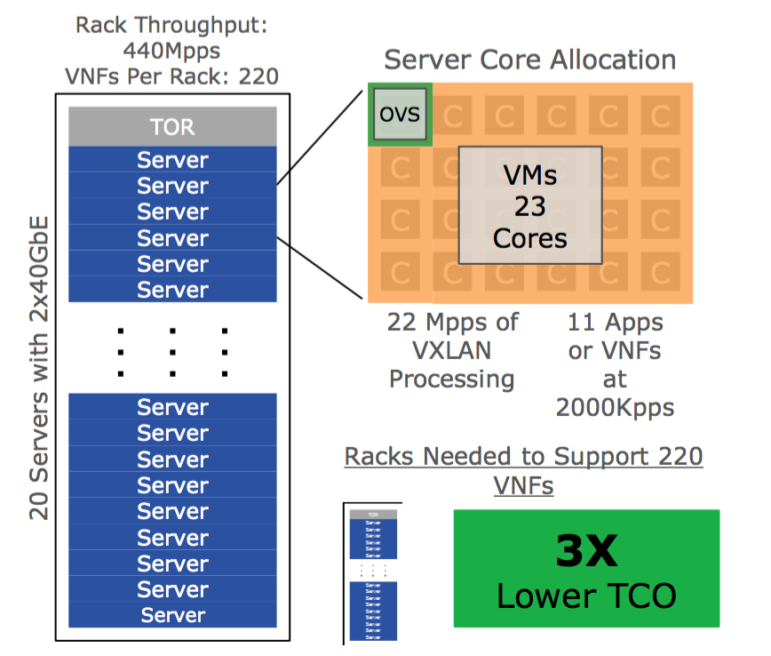
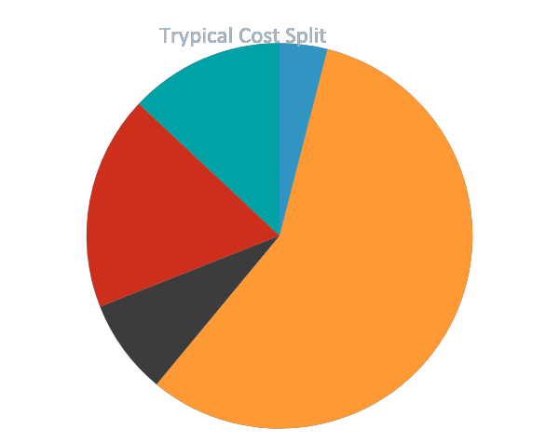
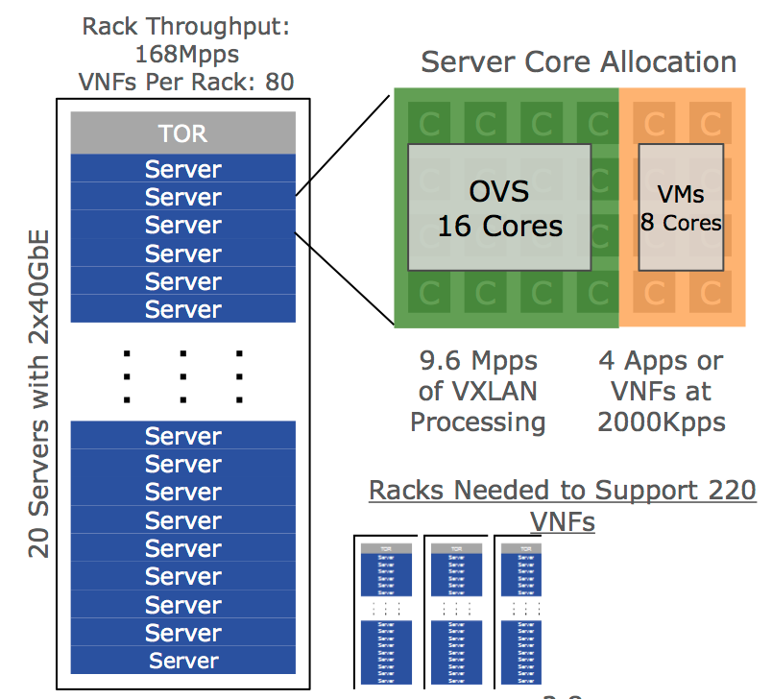
All major data center operators use acceleration: vRouter Acceleration & Offload greatly improves NFV TCO Equation
vR
13% Power
4% Other
vRouter
18% Power Distribution & Cooling
1
57% Servers
8% Networking
Equipment
2
Accelerated
vRouter
80%+ monthly data center costs attributed to servers and related power and cooling costs
Un-Accelerated
vRouter
~2x Lower TCO through CAPEX & OPEX reduction in Servers, Power & Cooling
Notes:
What does that give you?
TCO saving typically factor of 2: depends on workload, etc…
Efficiency depends to some extent on VNF
Above use-case is EPC

Slide 7
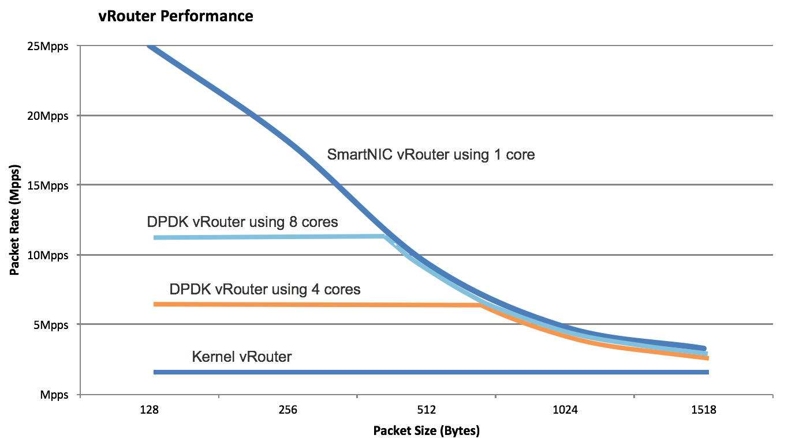
SmartNIC vRouter delivers Higher Performance, Lower CPU Count, Low Latency
Proven enhancement to software only Contrail solution:
Higher performance than DPDK vRouter
Lower CPU consumption than DPDK vRouter
Lower latency than SW only
Higher resiliency through always on SW slow path
Performance and TCO figures proven in the field
Product is Generally Available
Notes:
GA is part of Juniper GA (1908)

Slide 8






Features supported in initial release
Encapsulations
L3 overlay (IPv4 and IPv6)
IPv4 underlay
MPLSoGRE, MPLSoUDP, VXLAN
Forwarding
Flow Table
Next Hop ECMP
Mirroring
NAT
Link Bonding/LACP
VM Connectivity
SR-IOV
XVIO (eXpress VirtIO) / DPDK
Performance optimizations
Checksum offload
Large Segmentation Offload (LSO)
Jumbo Frames
OS & Orchestration
Host OS: Ubuntu, RHEL/CentOS
Guest OS: Ubuntu, RHEL/CentOS
KVM Hypervisor
OpenStack Integration
Operation & Analytics
Statistics synchronisation with vRouter
Notes:
Minimum/Initial feature set
Working with Juniper to make sure all key features of vRouter can be accelerated

Slide 9
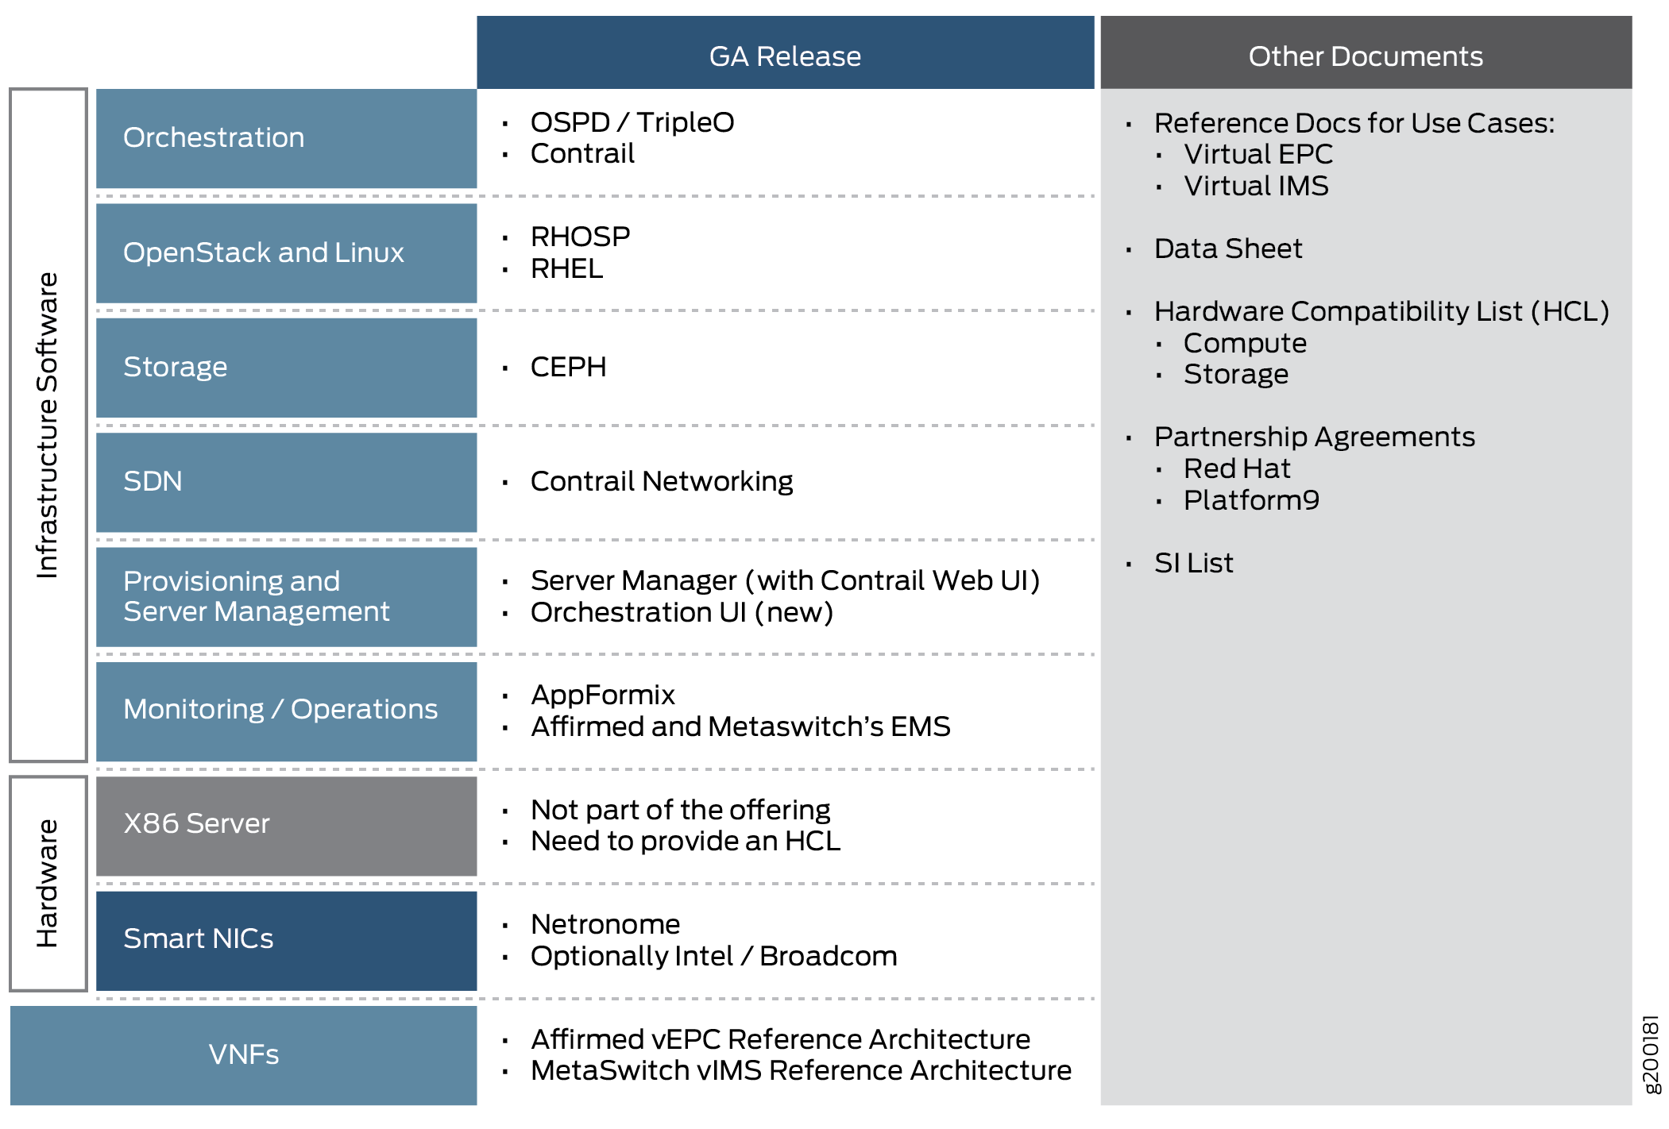
NFVI Component Overview
vEPC Reference Architecture
vIMS Reference Architecture
Various VNFs (vECP, vIMS, etc…)
REF: https://www.juniper.net/documentation/en_US/contrail-cloud10.0/topics/concept/solution-vepc-understanding.html
Notes:
How we fit into the stack
Part of SW stack; plug in for 2x performance gain
Integrated into full contrail sw stack
Is CEPH important to Orange?
Which VNF vendors to mention

Slide 10
Architectural Overview
OpenStack Nova
Control Node
Control Node
Seamless Integration with Control Plane
HOST
VM
Guest Application
OpenStack Ready
XMPP
Compute Node
virtio-net
...
L2 Traffic
vhostuser
OpenStack Nova
vRouter Agent (User Space)
VM
VM
VM
Container
Encapsulated Traffic
Virtio-forwarder
Linux Kernel
XVIO
vRouter Forwarding Plane (Kernel Module)
SR-IOV Connectivity
PMD igb_uio
USERSPACE
offloads
KERNEL
Kernel Datapath
Transparent Offload
Agilio CX
PCIe
Outer LPM and Next Hop
MPLS Label Lookup
Flow Table Policy
Deliver to Host Update Analytics
Decap
VF 1 | VF 2
Agilio CX
Accelerated Datapath
Phy1 | Phy 2
Notes:
Upstream allows seamless integration with vanilla Openstack and Contrail components
Hooks in Kernel vRouter allows for offloading to SmartNIC
Virtual instances connect to the offloaded dataplane via SR-IOV VFs resulting in a synergetic performance boost.
Virtio-forwarder offers generic virtio devices to VM resulting in complete flexibility

Slide 11
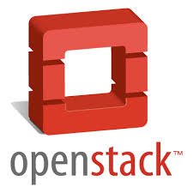
Flow of Events
x86 Userspace
(Nova, Neutron)
vRouter
CLI
Virtual Machine
Virtual Machine
vRouter
Subsystem
Virtual Machine
Virtual Machine
1
Apps
vRouter
Control
Apps
Apps
Apps
1
Apps
3
netdev or DPDK
netdev or DPDK
Miss
DP Ext.
1
Configuration via controller or CLI: BGP over XMPP
x86 Kernel
vRouter
Flow
Classify
vRouter
Forwarding
2
Offload forwarding: preemptively copied
Execute Action
5
SR-IOV /
VirtIO VFs
SR-IOV /
VirtIO VFs
3
Userspace agent populates kernel tables
4
2
PCIe
4
Offload flows: copy tables, sync stats
Agilio Intelligent Server Adapter (NIC)
Miss
vRouter Datapath
5
5
Datapath extension software
Datapath
Extension
or Plugin
P4 / C
in Sandbox
vRouter
Flow
Classify
vRouter
Forwarding
Execute Action
(e.g. Entunnel, Deliver to VM, Send to Port)

Slide 12
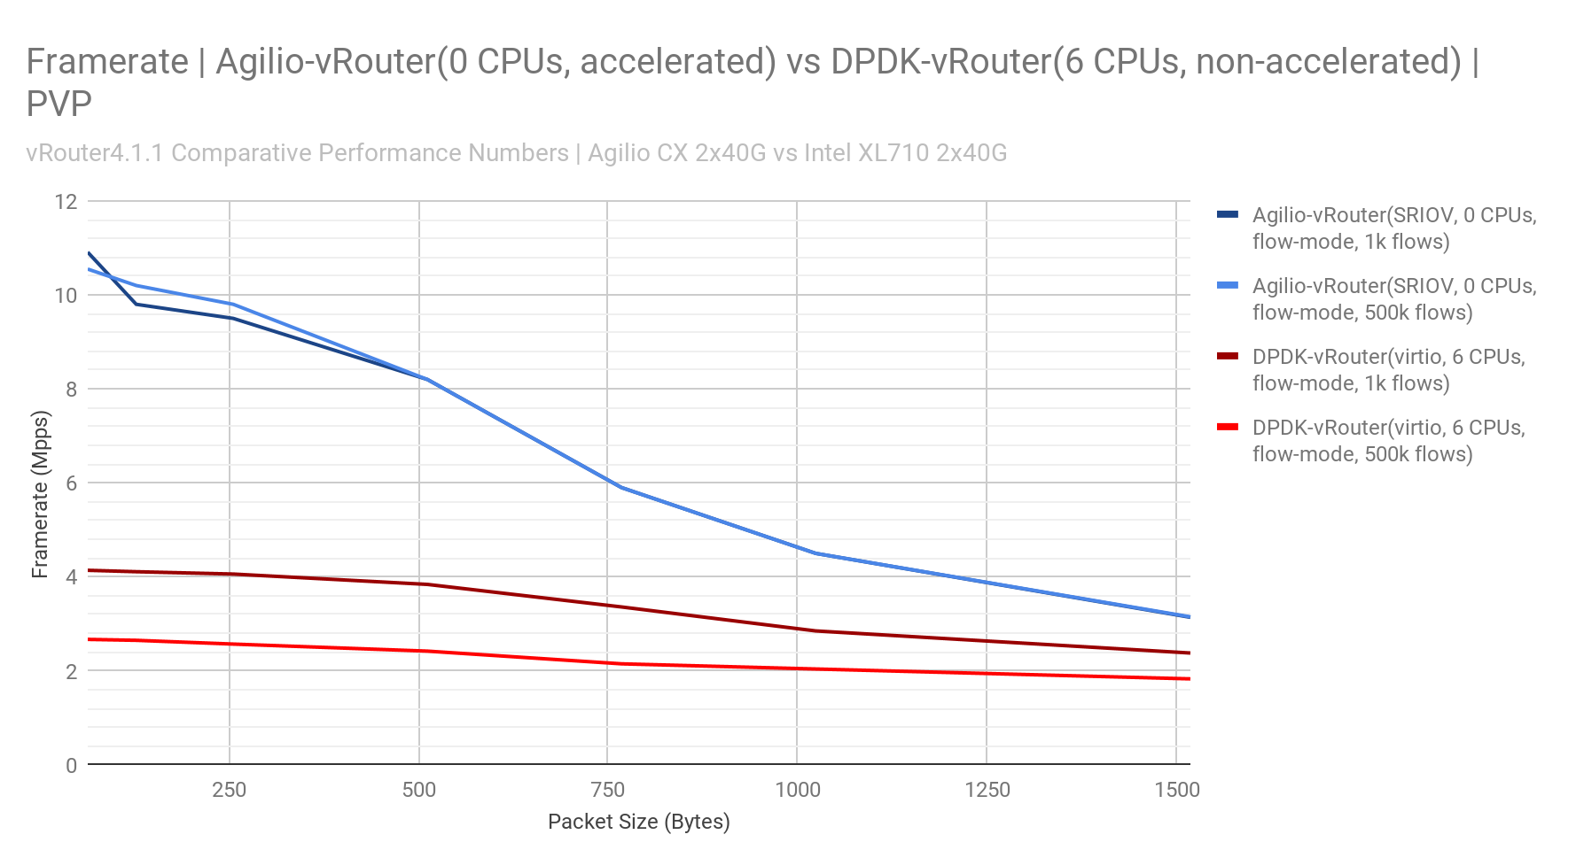
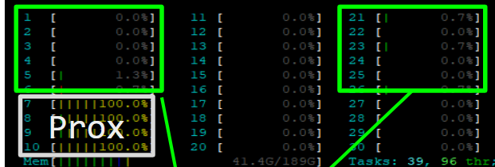
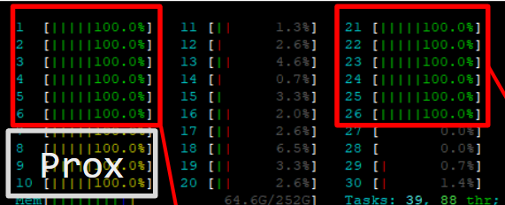
Agilio-vRouter offers 2x performance increase vs DPDK-vRouter
Agilio-vRouter @ 0 CPUs
/ 2 CPUs (virtio-forwarder)
Agilio vRouter resource usage
DPDK-vRouter @ 6 CPUs
DPDK vRouter resource usage
Notes:
Netronome’s Agilio® vRouter significantly increases the performance while reducing host resource usage compared to DPDK vRouter.
New connections are initially processed by the Contrail vRouter agent before being offloaded to the Agilio vRouter forwarding plane.
Agilio-vRouter significantly increases the performance of CN by offloading the vRouter/dataplane component to the SmartNIC.

Slide 13
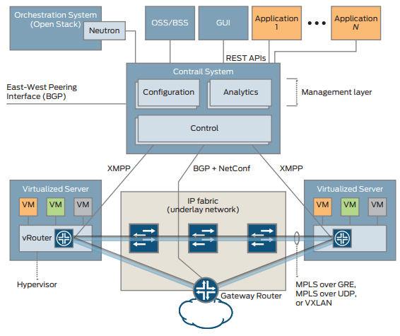
Operational Considerations
Upstreamed into OpenStack and Tungsten Fabric
No additional patching required
Largely transparent to upper layers of SDN architecture for seamless integration and operations
Lower resource/CPU usage results in:
Significant reduction in computational footprint
Massive CAPEX and OPEX savings
Supported deployment tools:
Juju (Ubuntu)
Heat templates (RHEL)
Notes:
CAPEX/OPEX ~30-50% saving

Slide 14
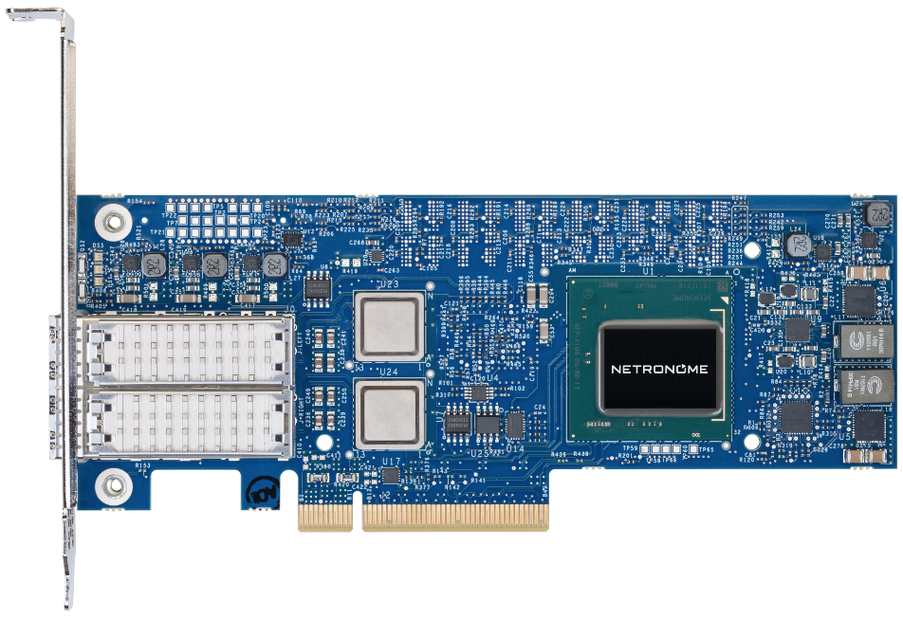
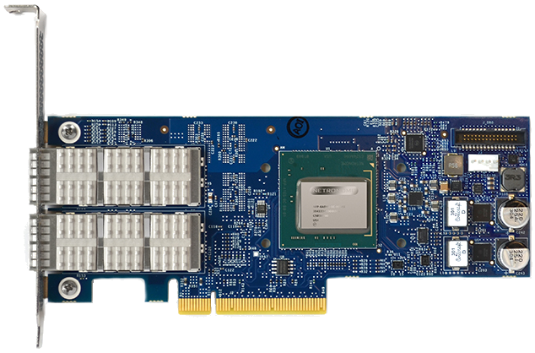
Agilio-CX SmartNICs at the cost of a standard NIC
Optimized for standard server based cloud data centers
Based on Netronome’s NFP 4000 chips
Low Profile Half Length PCIe form factor for all versions
Memory: 2GB DRAM
Single PCIe Gen3 x8
<25W Power, 15-20W operational
2x 10/25GbE
2x 40GbE
Notes:
Typical cards that are being deployed today
Form factor
Low Power
Favourable environmental factors
Competitive Price
Customers: under NDA. One is close partner to Orange

Slide 15
Live Demo

Slide 16
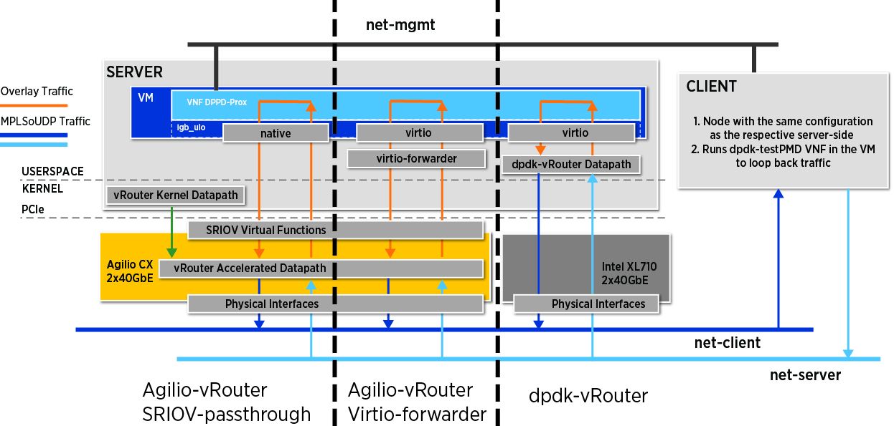
Benchmarking topology
Performance benchmarking was conducted by generating traffic at a VM using DPPD-Prox.
The traffic is sent to a second VM running the testpmd VNF which routes the traffic back to the first VM.
The measurements are taken at the first VM by analysing the characteristics of the return traffic.

Slide 17
References
https://www.netronome.com/products/agilio-software/agilio-vrouter-software/
https://www.netronome.com/products/agilio-cx/
https://github.com/Netronome/opencontrail-blueprints/blob/master/Hardware-Acceleration-Blueprint.md
https://github.com/netronome-support/vRouter
https://tungsten.io/

Slide 18
Q & A
Thank you!

